Slide 1




FEBRUARY 2025
UNICORNS 🦄
The Unicorns:
Aleix Cuevas
Aleix Revilla
Arnau Oller
Georgina Tarrés
Jan Baserba
Lucía Cortés
Roger Pérez
TH Corporate Action Sentinel
Identify. Analyse. Execute.
COPYRIGHT © 2024 TRADEHEADER, S.L.

Slide 2



The Challenge
The Complexity of Corporate Actions in Financial Markets
However, financial institutions face significant challenges due to high trade volumes and fragmented data sources.
With millions of trades processed daily across multiple asset classes, firms struggle to synchronize news-driven external events like corporate actions with their internal trade data.
The FINOS Common Domain Model (CDM) is a standardized, machine-readable framework for trade lifecycle events, enabling automation and interoperability across financial systems.
TradeHeader specializes in leveraging CDM to streamline trade processing, ensuring seamless integration, validation, and automation of financial transactions.
The lack of standardized integration requires manual intervention, leading to errors, inefficiencies and delays in critical decision making.
2
Notes:
Massive Trade Volumes: Financial institutions process millions of trades daily, spanning multiple asset classes and counterparties. Managing corporate actions manually at this scale is inefficient and prone to errors.
Fragmented Data Sources: Corporate action events are scattered across various news sources, regulatory announcements, and proprietary feeds, making timely detection challenging.
The Need for Standardization: The FINOS Common Domain Model (CDM) provides a unified approach to trade modeling, ensuring consistent representation and automation across the financial ecosystem. However, firms struggle to integrate any external event into the model, which often requires manual intervention and is prone to errors. Corporate action events are one of those external events that require seamless integration.

Slide 3




The Solution
TradeHeader Corporate Action Sentinel
Powered with AI to:
Extract corporate action events from news
Generate and validate
ISO 20022 notifications
Enrich reference data and match against opened trade positions
Integrate into FINOS CDM, for trade impact and decision making
UI monitoring to visualizes events, identify trade impacts and make decisions seamlessly
3
Notes:
An AI-powered platform that automates the end-to-end corporate action lifecycle:
Synthetic News Simulation: The solution currently operates with synthetic news data to simulate real-world event flows. Future versions will integrate with external news APIs.
AI-Generated ISO20022 Message: Reads corporate action news and, using AI, generates an ISO20022 corporate action notification with fine-tuning to ensure accuracy. The solution currently identifies Cash Dividend events only. Future versions will extend to other CA events.
ISO20022 Validation: The generated message is validated using the TradeHeader ISO20022 validator, ensuring compliance with business constraints.
ISIN Enrichment: The ISIN is enriched through a lookup mechanism. Currently, this is simulated with a CSV database, but future enhancements will integrate an external ISIN API.
AI-Generated CDM Integration JSON: Once the ISIN is available, AI is used again to generate and fine-tune a JSON format compatible with FINOS CDM for trade impact analysis.
UI Monitoring: Visualizes events, trade impacts, and position changes seamlessly.
By leveraging CDM, our solution ensures that corporate action events are automatically structured in a standardized format, enabling seamless integration with trading systems and reducing discrepancies.

Slide 4
Key Features
What makes the magic happen
AI-Powered ISO20022 message creation with built-in fine-tuning.
ISO 20022 business validation using TradeHeader's proprietary validator.
ISIN enrichment via Database Lookup (CSV-based, with future API integration).
Advanced trade impact analysis using FINOS CDM.
Dynamic position calculation for post-corporate action events.
Intuitive UI for effortless user interaction and data visualization.
2

Slide 5




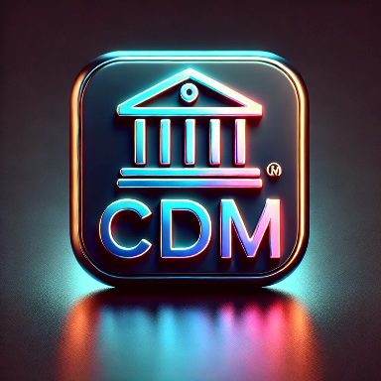


Technical Architecture
News Feed API
AI CDM CA Mapper (Anthropic Claude 3 Haiku)
AI ISO Mapper
(Anthropic Claude 3 Haiku)
ISIN Lookup
Enrichment
ISO 20022 Enriched
Trade Matching in Trades Database
ISO 20022 Notification
TradeHeader
ISO 20022
Validation
Corporate Action Event in CDM Format
1
News notification to user
ISO 20022 Validated
CDM Generation of resulting event(s)
2
Proposed CDM Resulting Trade(s)
Resulting trade(s) for user acceptance
CDM Execution of resulting event(s) after user acceptance
3
Accepted and valid CDM Resulting Trade(s)
Notified trade(s) execution

Slide 6
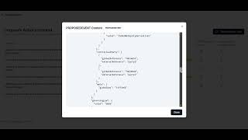
Prototype Demo

Slide 7
Next Steps
Future enhancements in our path to production
Integration with External News APIs for real-time event detection.
AI empowered news management, to fix incomplete ISO 20022 notifications.
Automated ISIN API Lookup for seamless enrichment.
Enhanced Machine Learning Models for smarter and wider range event detection, currently covering Dividend events only.
Expanded trade impact scenarios across diverse financial instruments.

Slide 8





Contact
THANK YOU!🦄
TRADEHEADER, S.L.
+34 619831118 (Spain)
+44 020 3287 1545 (UK)
+1 347 2846531 (US)
info@tradeheader.com
www.tradeheader.com

Slide 9
Business Value Proposition
1. Operational Efficiency & Cost Reduction
Automates manual corporate action processing, reducing the need for extensive back-office operations.
Cuts down processing time from hours/days to real-time execution, significantly lowering operational costs.
2. Risk Mitigation & Compliance
Ensures ISO20022 and ISDA CDM compliance, reducing regulatory risk.
Minimizes human errors in event detection, trade impact analysis, and data transformation.
3. Faster & More Accurate Decision-Making
Real-time event detection and trade impact assessment allow firms to react instantly to corporate actions.
Prevents missed or delayed corporate action updates that could lead to financial losses or settlement failures.
4. Seamless Integration & Scalability
ISO20022 standardization ensures easy integration with existing financial infrastructure.
The system is scalable, accommodating more asset classes and financial instruments over time.
5. Competitive Advantage in Capital Markets
Firms leveraging this system gain a real-time strategic edge, optimizing their portfolio adjustments faster than competitors.
Reduces the dependency on third-party corporate action data providers, lowering data acquisition costs.
6. Enhanced Transparency & Auditability
Provides a clear and traceable corporate action workflow, improving internal governance.
Intuitive UI and structured reporting enhance visibility across trading desks, compliance, and risk teams.
This solution transforms corporate action processing from a reactive, fragmented process into an AI-driven, automated, and impact-aware workflow, delivering measurable business benefits.
2

